Slide 1

Advanced application development
REVIEW 1
Presentation
By ATHIF M (727821TUIT013)

Slide 2
Topic : Online Job Application Portal
Problem Statement:
In the current employment landscape, the process of job application and management often involves cumbersome procedures for both employers and job seekers. Employers face challenges in efficiently posting job listings and managing applications, while job seekers encounter difficulties in finding relevant opportunities and tracking the status of their applications. The lack of a centralized and user-friendly platform contributes to inefficiencies, data security concerns, and an overall suboptimal experience in the job application process.
Users of the System:
1. Job Applicant 2. Admin

Slide 3
Modules of the Application:
ADMIN:
Register
Login
Post Free Job details
Post Paid Premium Job Details
Edit Job Details
Delete Job Details
View All Jobs
View All Applications
Change Status of Application
View Payment History
View all user accounts
Logout

Slide 4
APPLICANT:
Register
Login
View All Free Jobs
Apply for Job
Can apply for only 5 jobs per day as normal user
Can pay and upgrade to premium user
Can do the payment
As premium user can view all premium jobs
As premium user can apply for n number of jobs
Check the Status of Application
Delete Application
View or Edit his user account
Logout

Slide 5
Technology Stack:
Front End
React, HTML, CSS, JavaScript

Slide 6
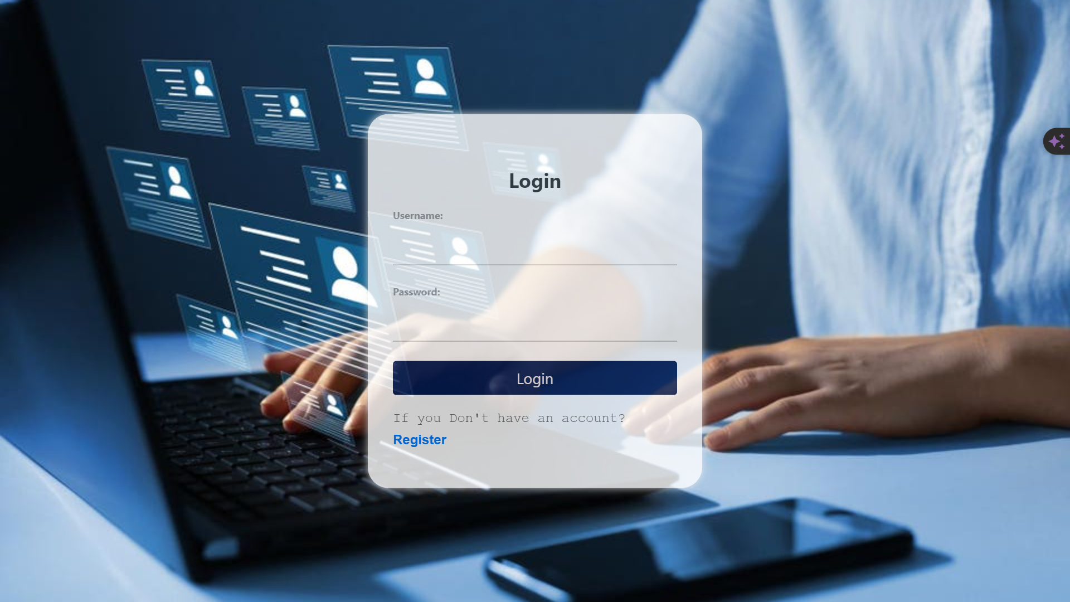
Sample Screen Shots From Frontend
Login Page

Slide 7
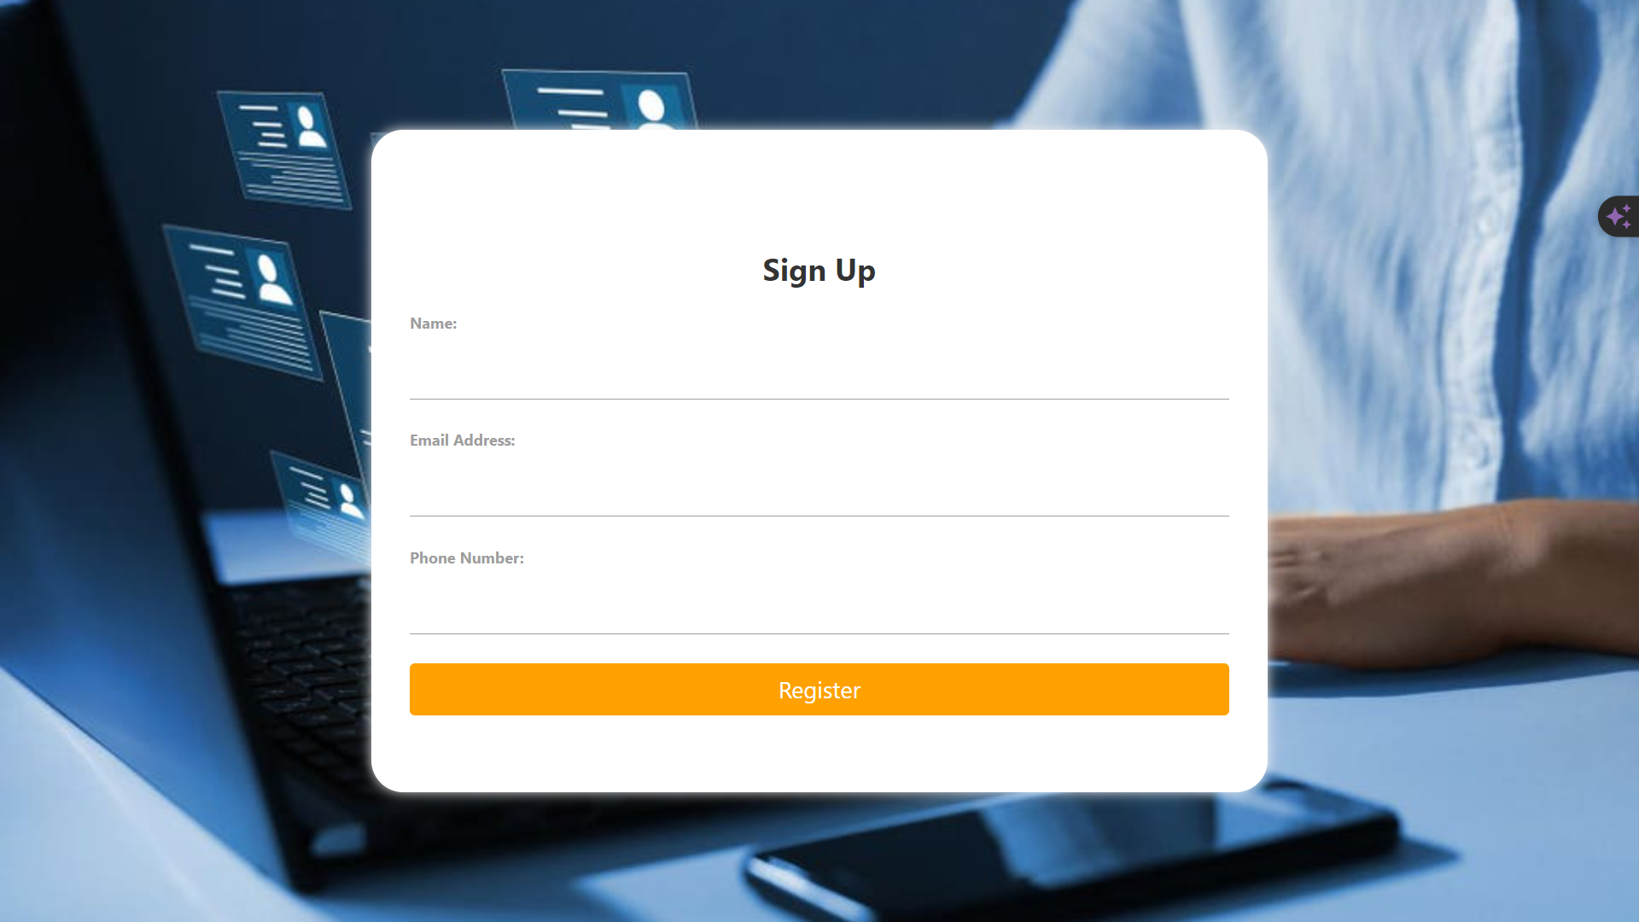
Sign Up Page

Slide 8
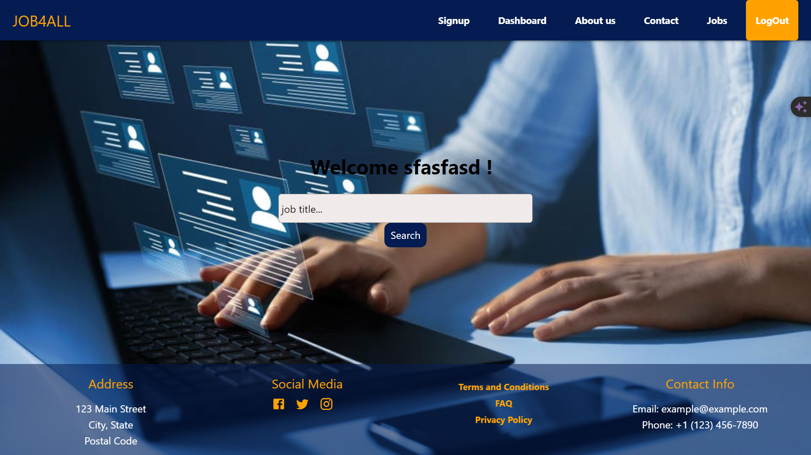
Home Page

Slide 9
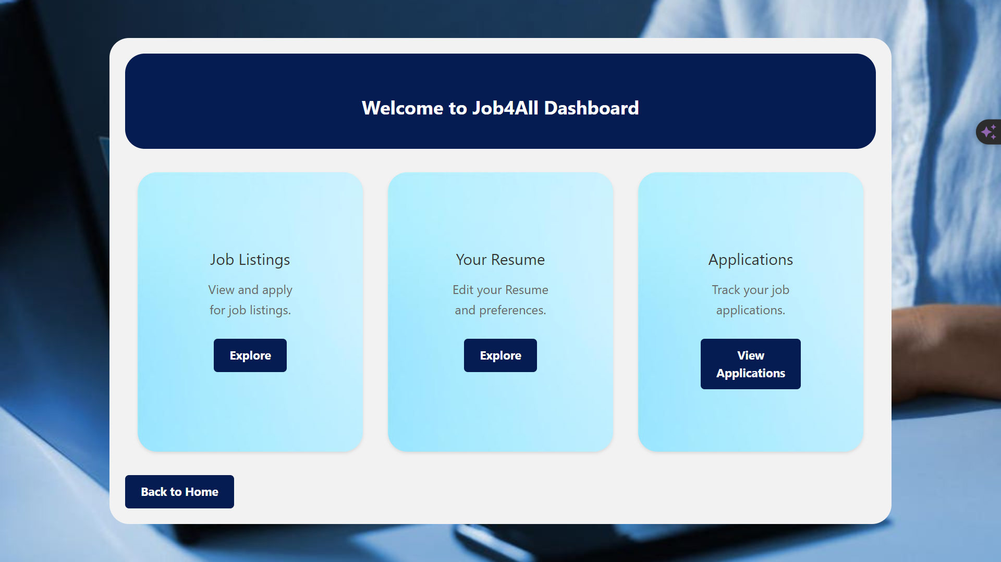
Dashboard Page

Slide 10
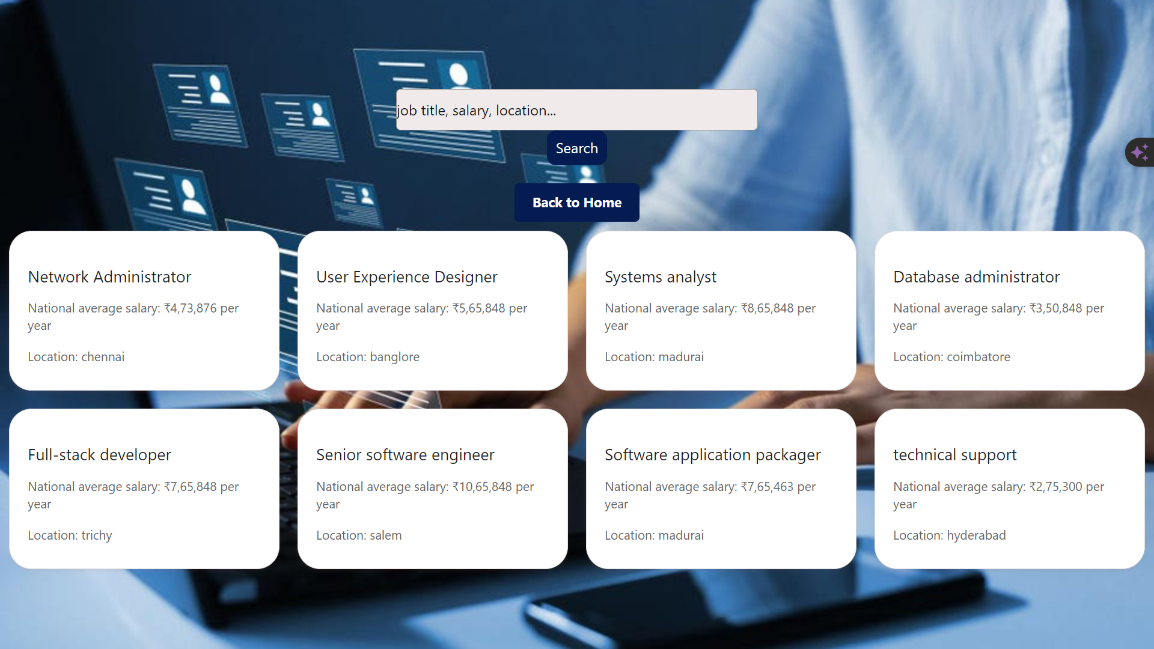
Job Application Selection Page

Slide 11
Upcoming Features: Planning to take this to international level and Planning to conduct interviews and more, Easy payment methods will be provided, Resume builder option will be updated, More Job applying plans like (Basic, gold, premium, etc.)
Will be available as soon as possible. Other Companies also can collab with us and post job applications without site admin approve by prior approval.
CONCLUSION: In summary, our job search project offers a user-friendly platform equipped with innovative features designed to streamline the job search process. With a commitment to inclusivity, integrity, and ongoing improvement, we aim to empower individuals and organizations alike, fostering meaningful connections and driving career success.

